Slide 1
Cluster Analysis
Data Set: USArrests
Script: ClusterDemo.R

Slide 2
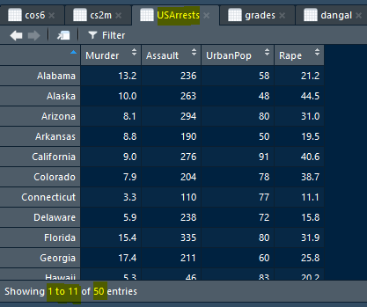
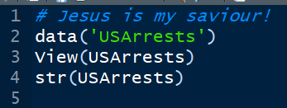
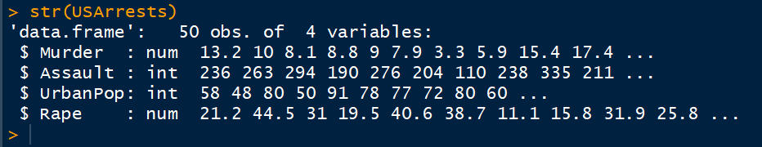
Access Data
Why some are num and some are int?

Slide 3
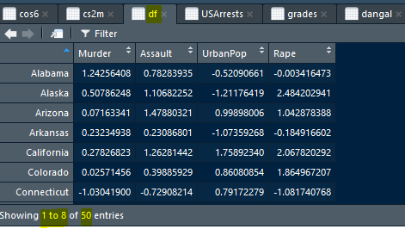
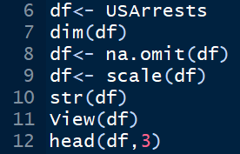
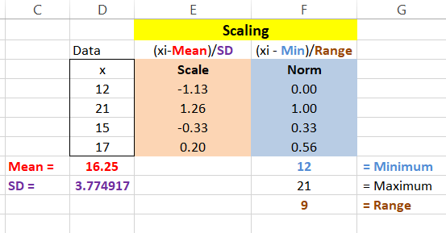
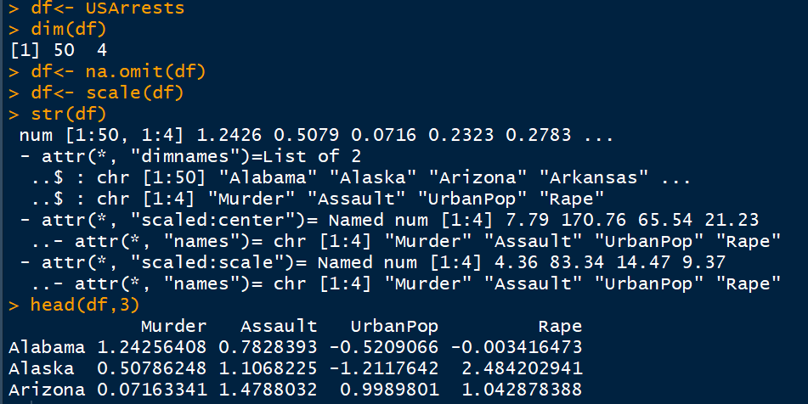
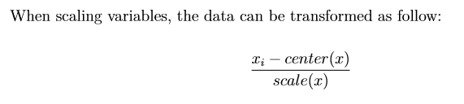
Scale the data and remove NAs
View df
Data is scaled

Slide 4

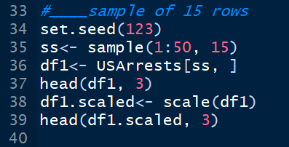
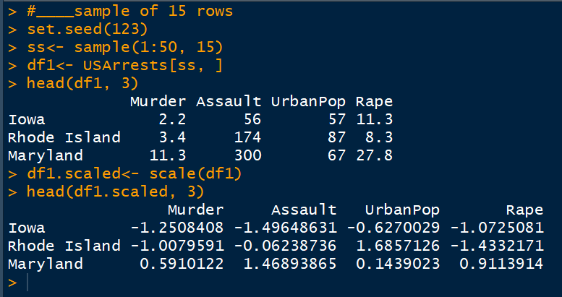
Distance Matrix Computation
We will take 15 sample rows so that the diagram and calculations remain easy to understand

Slide 5
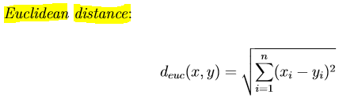
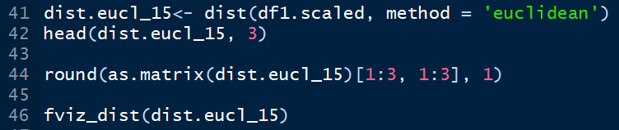
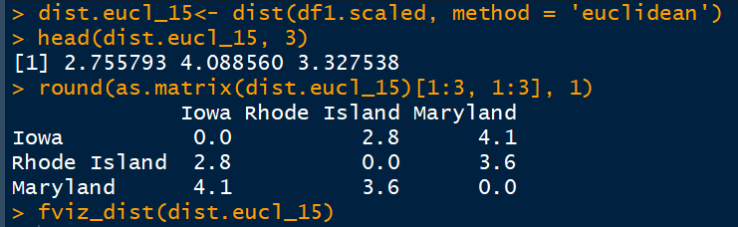
Euclidean Distance
Euclidean Distances are put in a matrix, only 3 cities are shown
Distances are rounded to one decimal place

Slide 6
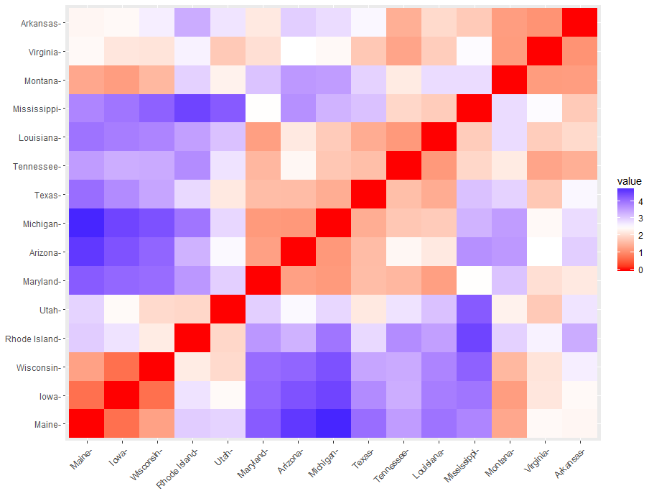
High Distance
Less Distance

Slide 7
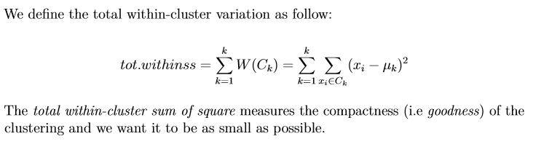
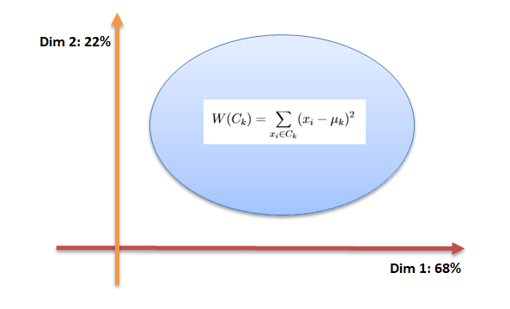
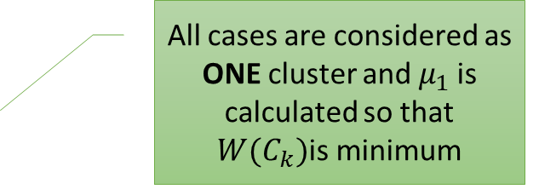
How clustering happens?
All variables are converted into two only: Dim 1 and Dim2
All cases are considered as ONE cluster and $μ_{1}$is calculated so that $W(C_{k})$is minimum
Age | Income | Savings | Expenses
30 | 36 | 18 | 9
18 | 35 | 19 | 8
30 | 35.5 | 18.5 | 8.5
Age, Income, Saving, Expenses
Wealth ; Budget
Centroid

Slide 8

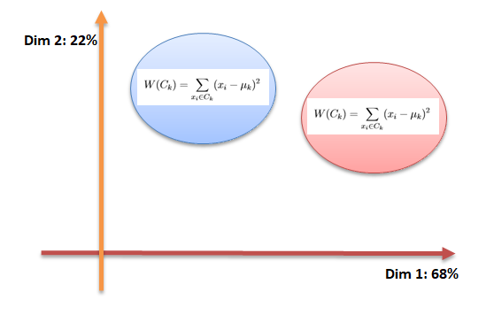

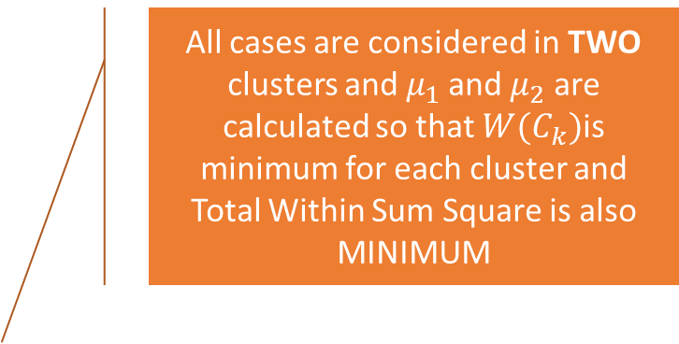
Two Clusters
All cases are considered in TWO clusters and $μ_{1}$and $μ_{2}$ are calculated so that $W(C_{k})$is minimum for each cluster and Total Within Sum Square is also MINIMUM
This is to be kept MINIMUM

Slide 9
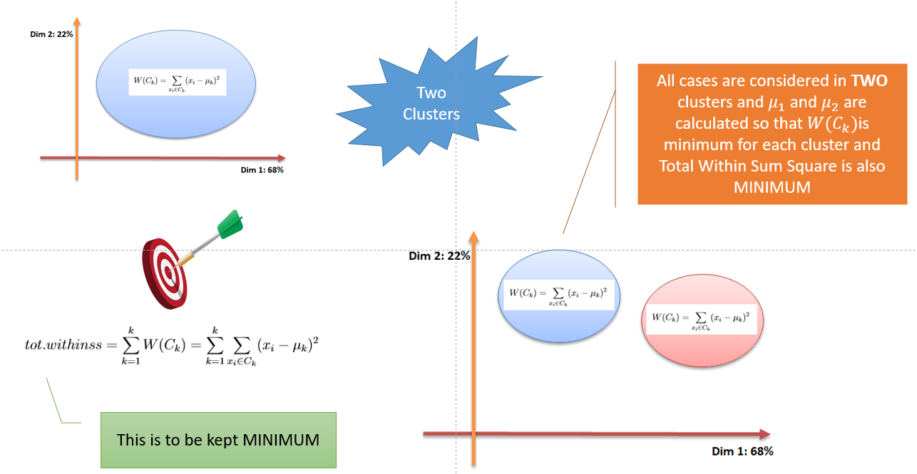
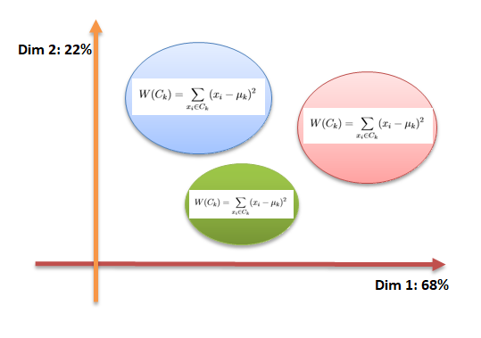

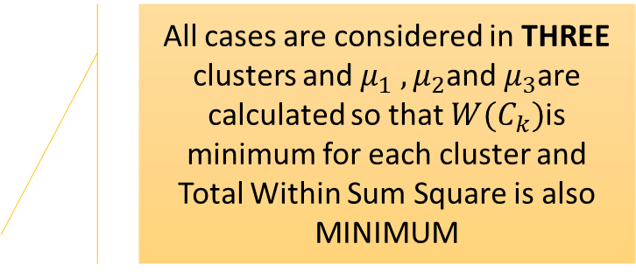
Three Clusters
All cases are considered in THREE clusters and $μ_{1} , μ_{2}$and $μ_{3}$are calculated so that $W(C_{k})$is minimum for each cluster and Total Within Sum Square is also MINIMUM
1→ 100, 2→ 80, 3→ 60, 4→ 55, 5→ 52, 6 → 51.5

Slide 10
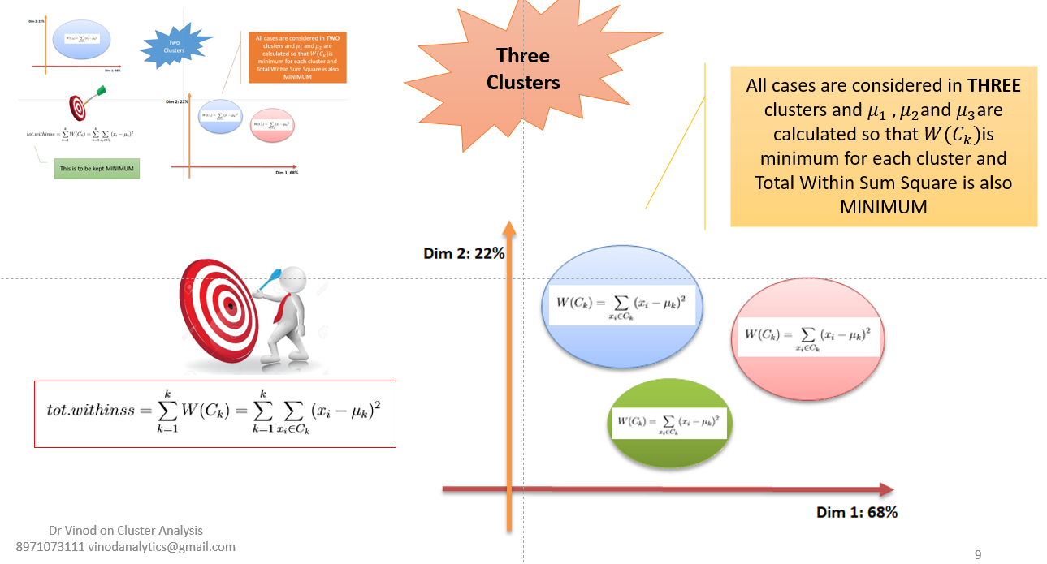
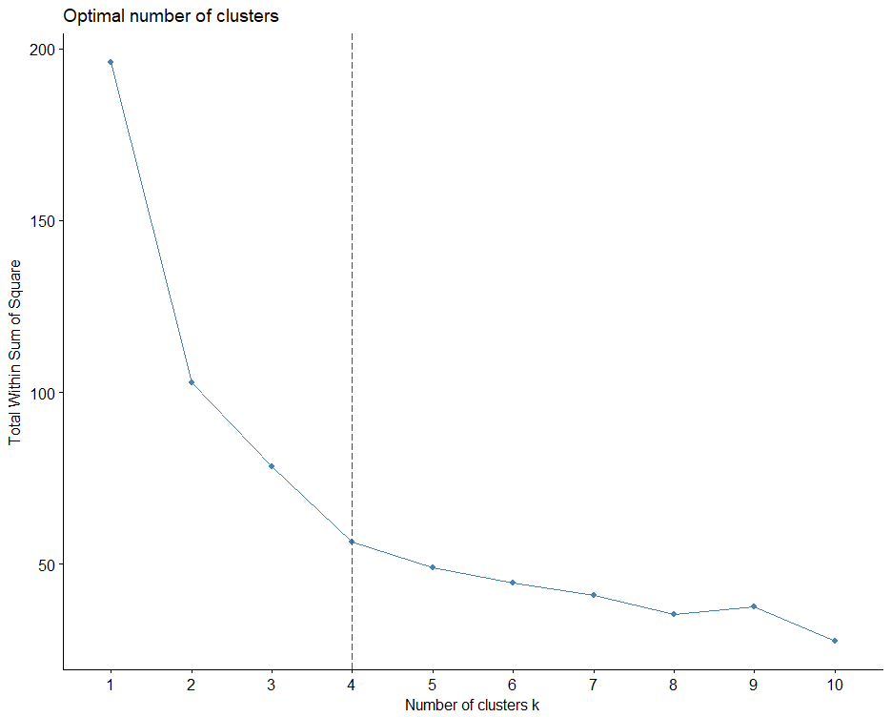
After 4th cluster REDUCTION in wss is very marginal
This process is repeated till further reduction in wss is not possible or very less
1→ 100, 2→ 80, 3→ 60, 4→ 55, 5→ 52, 6 → 51.5

Slide 11
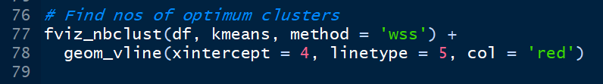


All 50 cases
totss = 196
Numbers of Optimum clusters

Slide 12
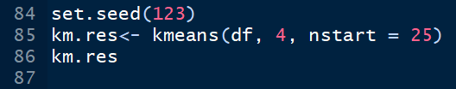
k-Means Clustering
R will start with 25 random starting points and find with lowest within cluster variation

Slide 13
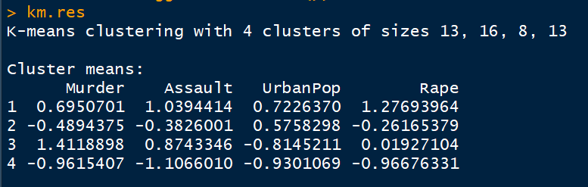
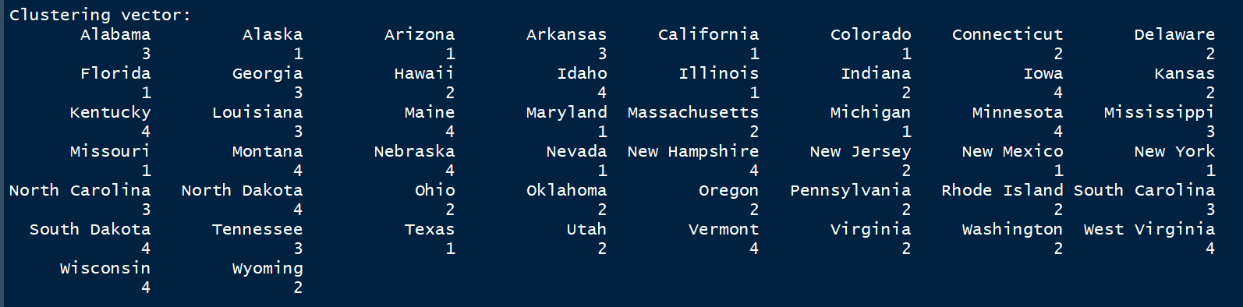
Profile of each cluster: Scaled data

Slide 14
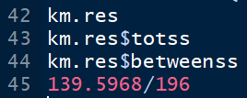

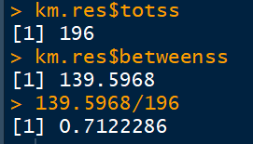
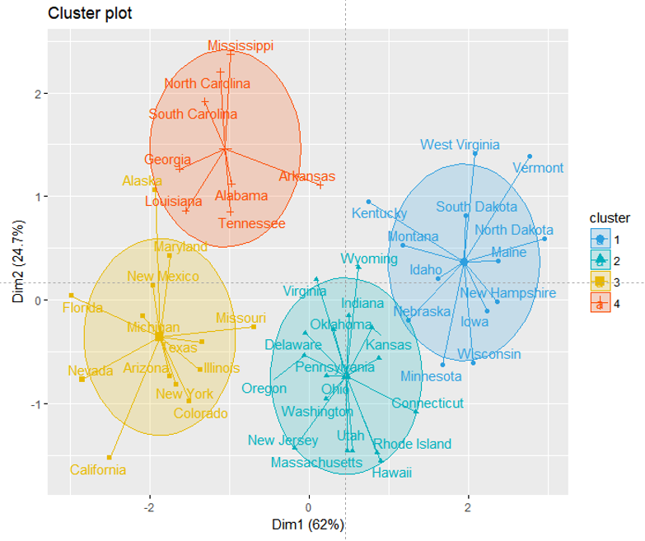
Useful information about your Clusters
km.res will give you plenty of information

Slide 15
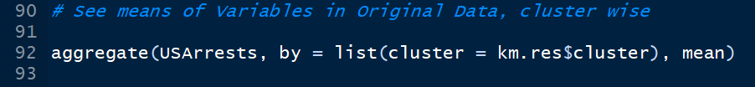
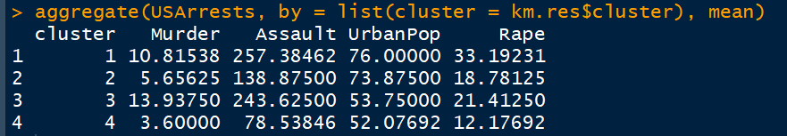
Profile of each cluster: Original data
Original ↑
Scaled →

Slide 16
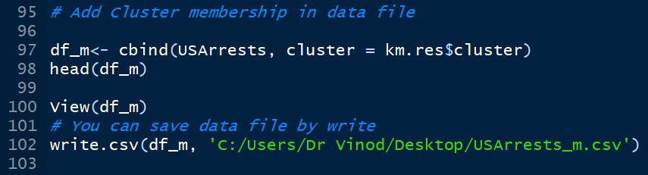
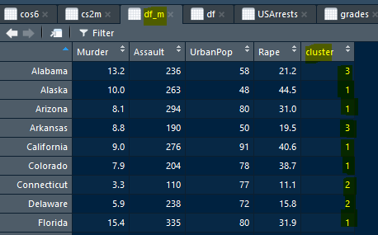

See Cluster Membership in Data File

Slide 17
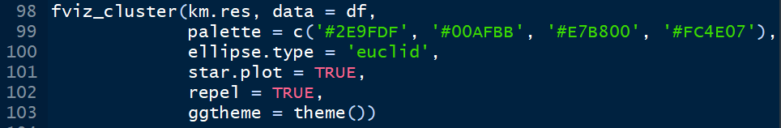
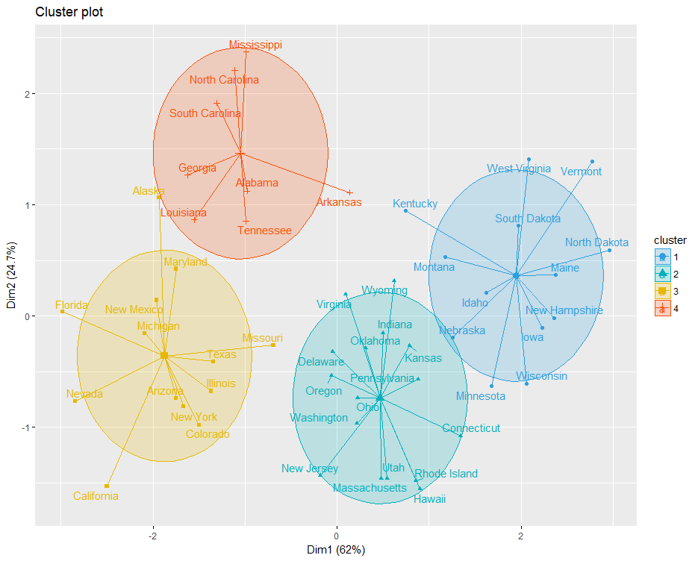

Slide 18
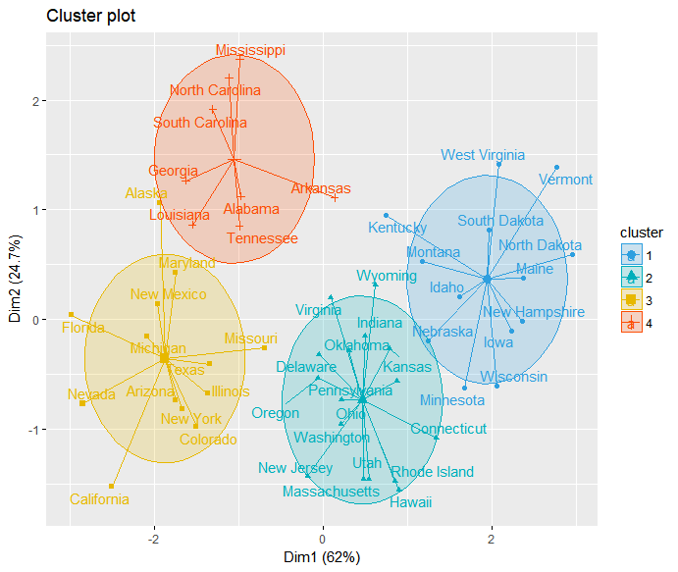

Slide 19
Lets Try More!

Slide 20
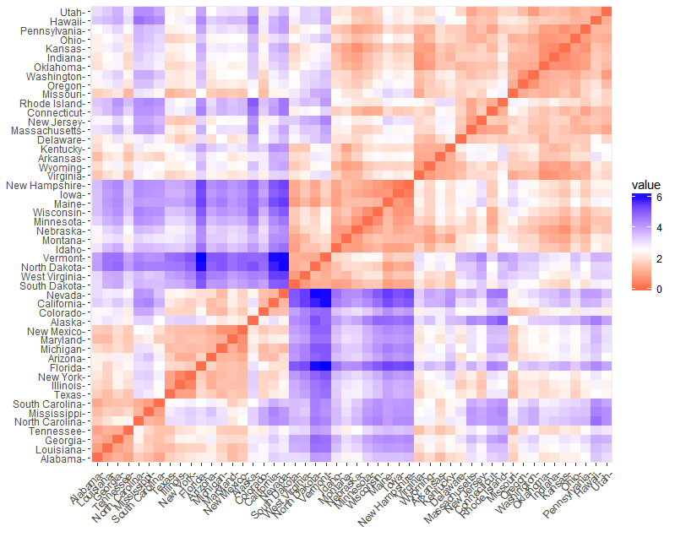
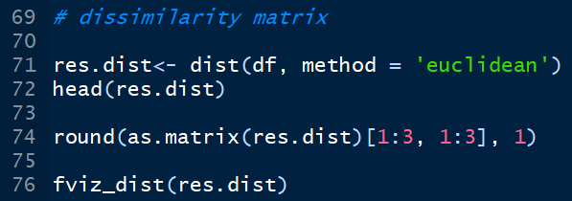
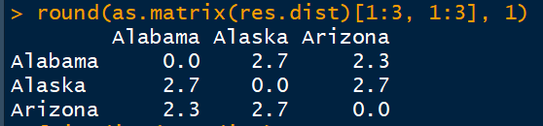

Slide 21

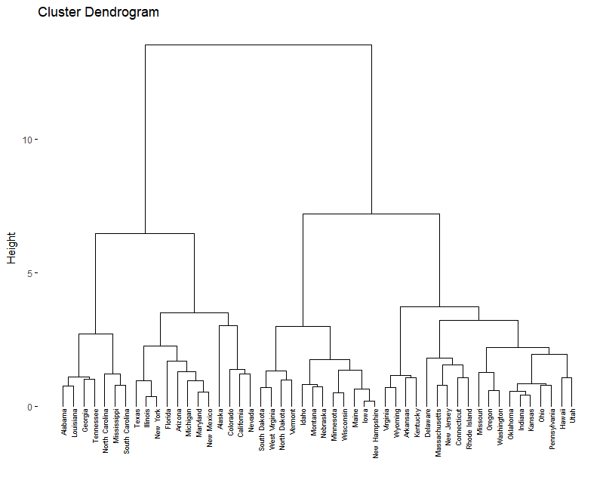
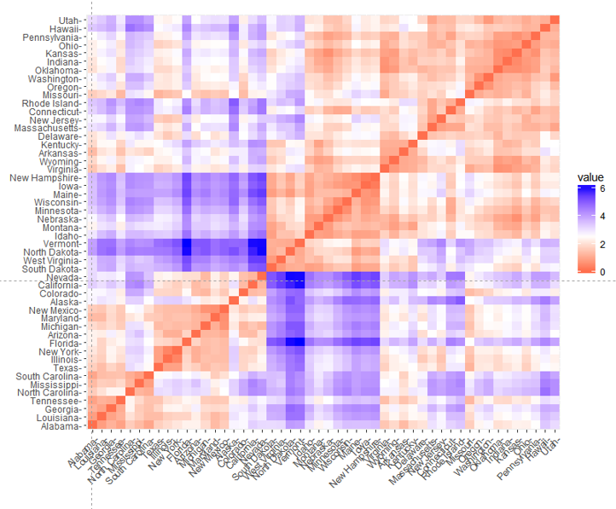
Hierarchical Clustering: (Agglomeration) Linkage Methods
res.dist
There are many methods of linking cases to form clusters. Most popular are Complete Linkage and Ward methods.

Slide 23
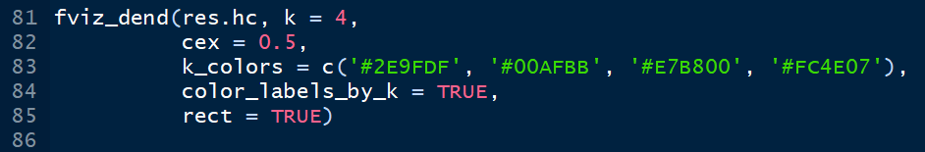
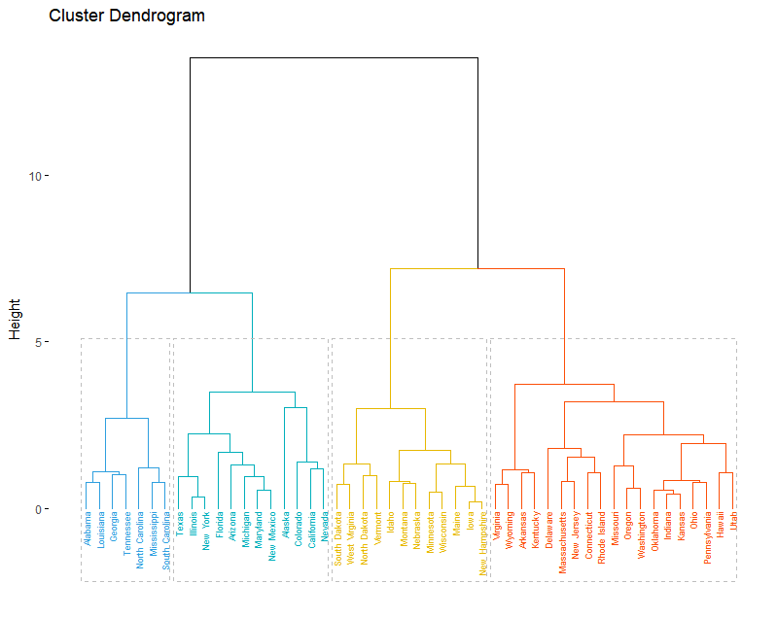

Slide 25
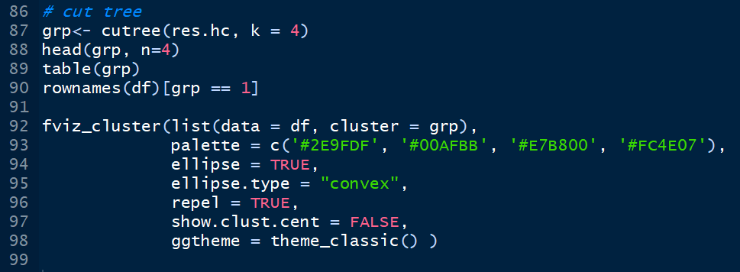
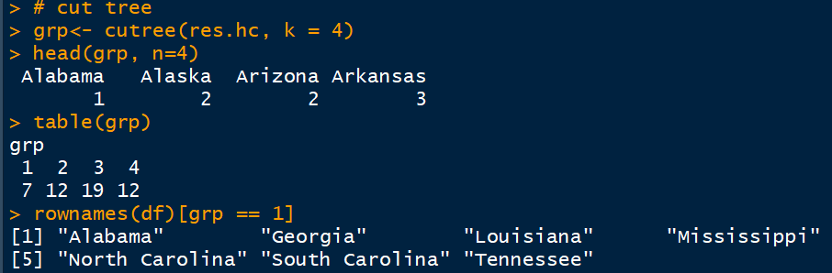
More Beautiful Diagram

Slide 26
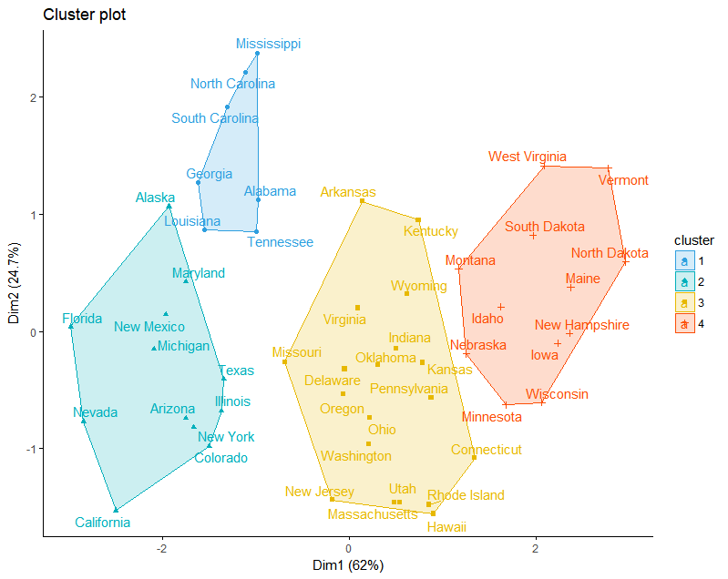

Slide 27
Exercise: %>% Data: RBI %>% Find appropriate clusters through K-Means and Ward Method and compare clusters. %>% Write a small report on Clusters (Profile them so that users can be benefited)

